Slide 1
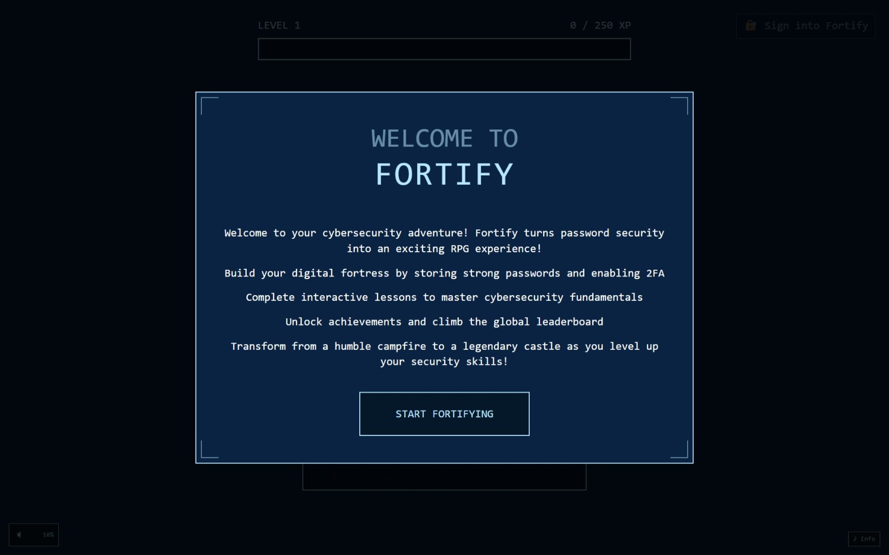

Slide 2
Summary
Fortify is designed as a gamified cybersecurity education platform that reimagines password management as an interactive, RPG-inspired experience. Instead of simply checking if a password is weak or strong, Fortify places users on a journey where their digital defenses visibly grow as they adopt stronger security practices. By building and evolving a virtual fortress, players earn XP through good password hygiene, enabling two-factor authentication, and completing lessons.
The key innovation lies in combining traditional password analysis with a visual and game-like reward system. As users improve their security, they watch their base transform step by step — from a fragile campfire into a fortified medieval castle. This visual metaphor makes the abstract world of password security tangible and memorable. Combined with achievements, leaderboards, and interactive quizzes, Fortify turns security education from a dry requirement into a rewarding adventure.

Slide 3
Demo
Please watch the demo video!
The best way to understand Fortify is to experience it firsthand. A local demo can be launched via the setup instructions in the repository, allowing judges or users to sign in and explore features directly. The demo highlights the password vault, the fort’s visual evolution, the achievement system, and the lessons panel in action. Watching the fortress transform from a campfire into a castle as new passwords are added provides an immediate sense of progression and reward.
Key demo moments include showing how the system responds to weak versus strong passwords, how enabling 2FA gives bonus XP, and how quizzes reinforce knowledge in a fun way. The clean retro aesthetic and responsive animations create a polished experience, while the achievement popups and leaderboard add excitement. Taken together, these elements make Fortify an engaging demonstration of how gamification can change the way people think about cybersecurity.

Slide 4
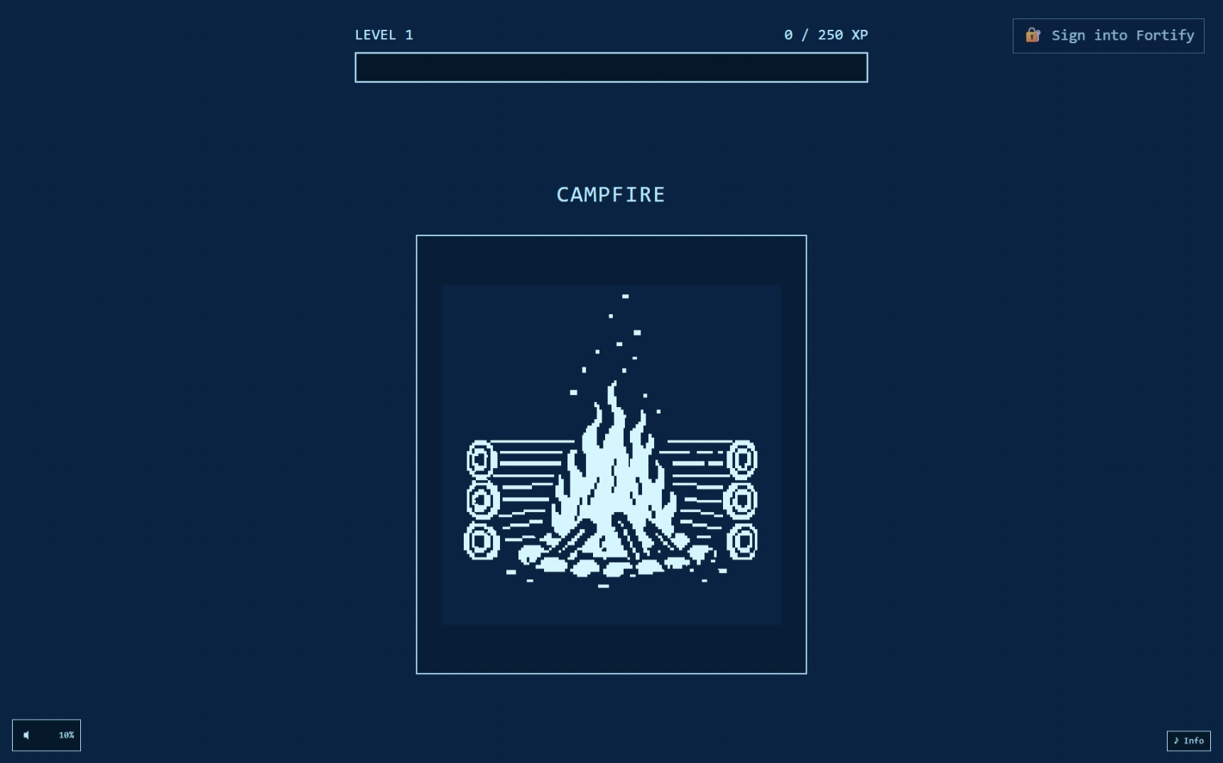

Slide 5
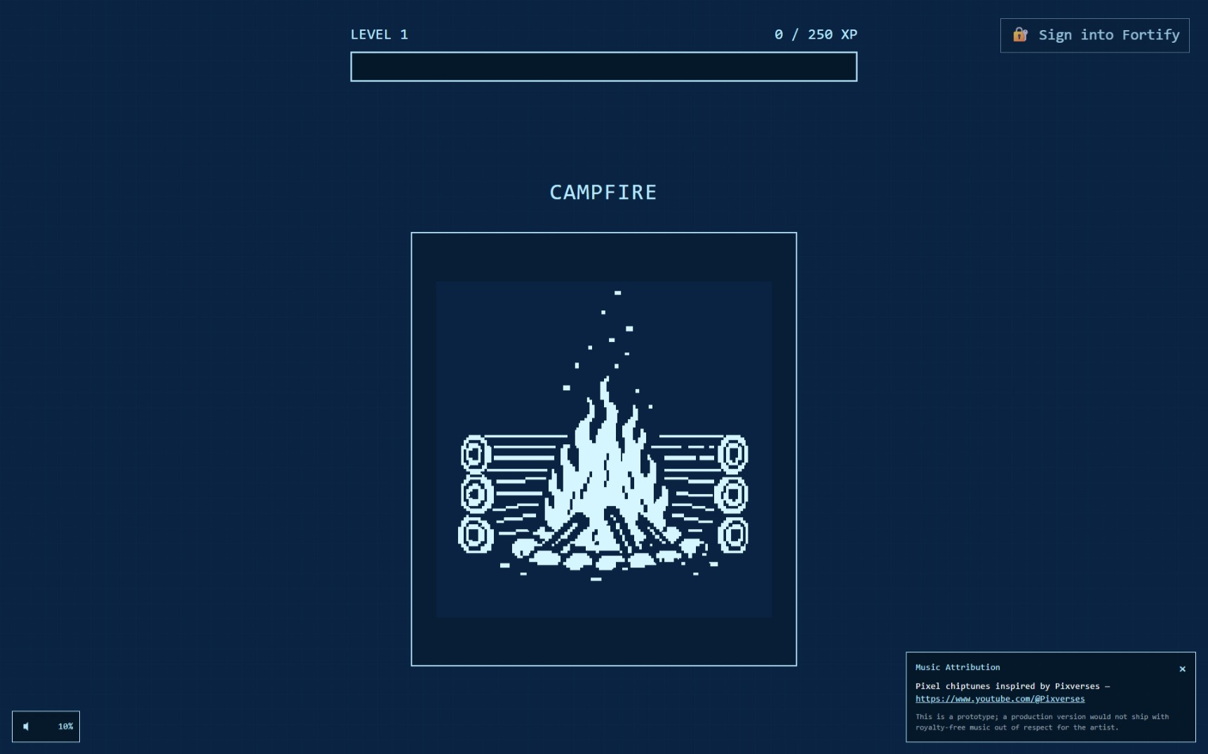

Slide 6
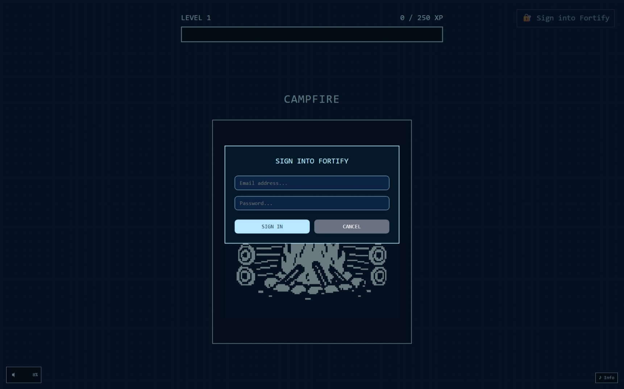

Slide 7
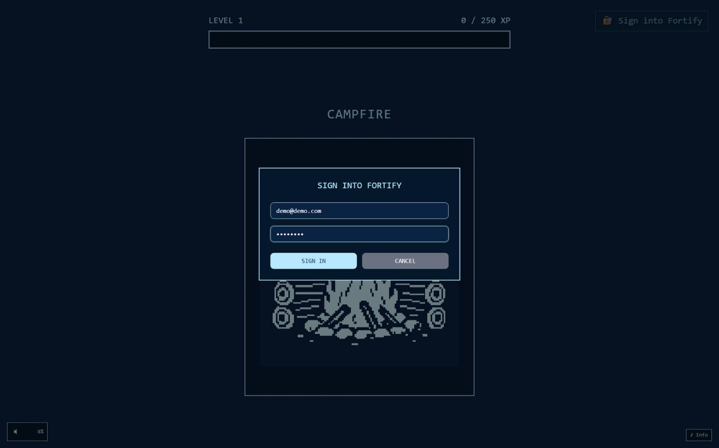

Slide 8
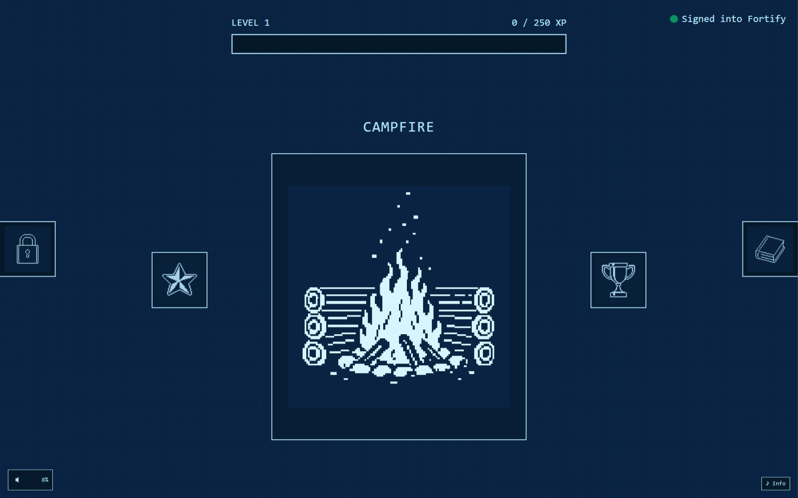

Slide 9
Key Features
Fortify’s feature set is built around both practical security tools and engaging gamification mechanics. At its core, the Gamified Password Vault allows users to add and manage simulated credentials, with each password contributing XP based on its strength and uniqueness. The Fort Evolution System is the visual centerpiece: users start with only a campfire, but as they accumulate XP, their base develops into a hut, a palisade, and ultimately a legendary castle.
An Achievement System reinforces milestone behavior by awarding badges for actions like enabling 2FA or creating long, diverse passwords. The Interactive Lessons panel provides quick quizzes on security fundamentals, ensuring learning is embedded in the gameplay. A Global Leaderboard creates a sense of competition, encouraging users to maintain strong practices to see their fortress ranked against others. Behind the scenes, Real-time Password Analysis offers instant, transparent feedback, teaching users why a password is weak or strong. Bonus XP is also awarded when users enable Two-Factor Authentication, further normalizing this best practice.

Slide 10
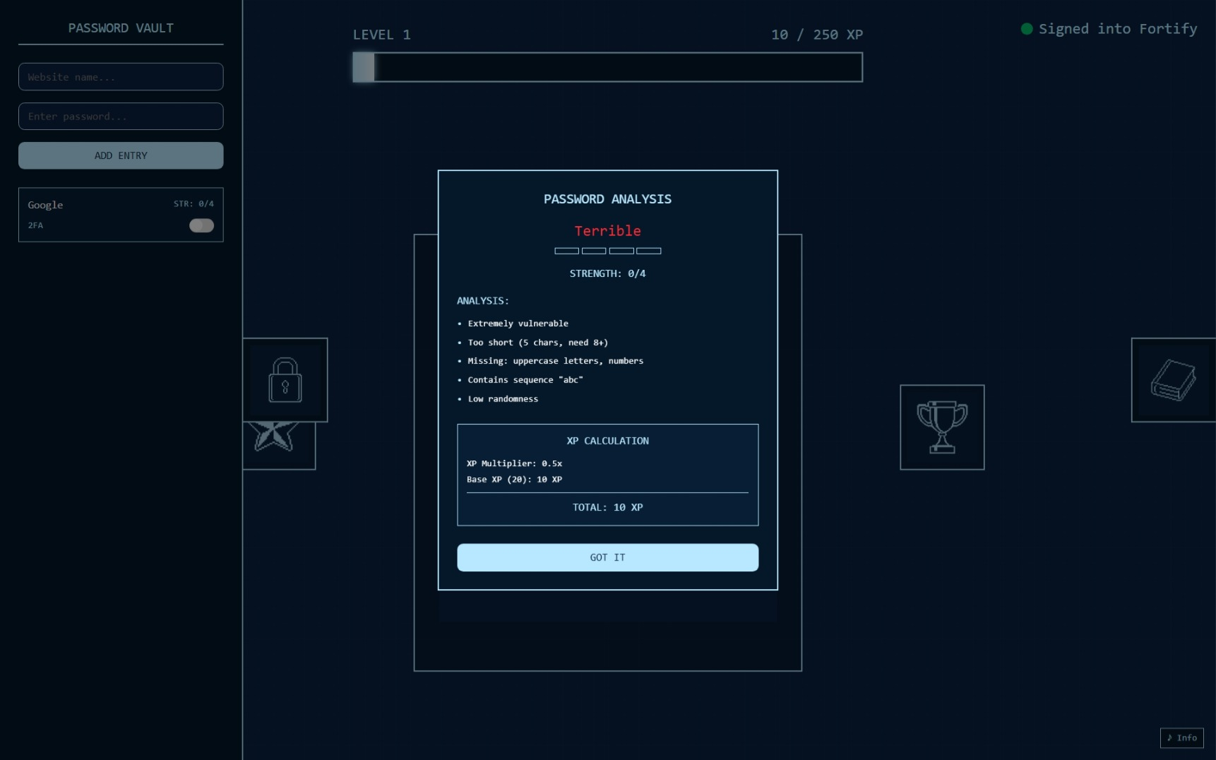

Slide 11
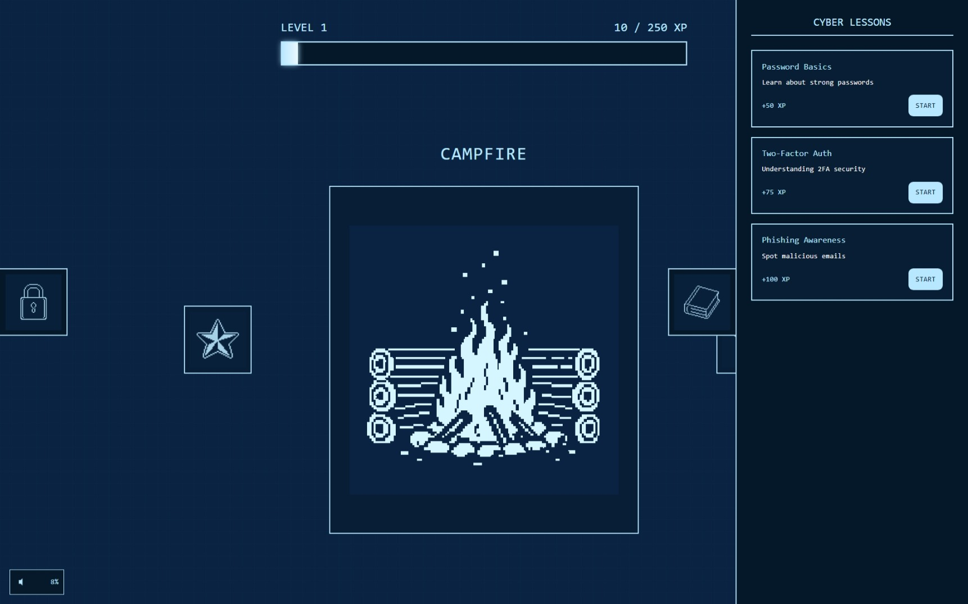

Slide 12
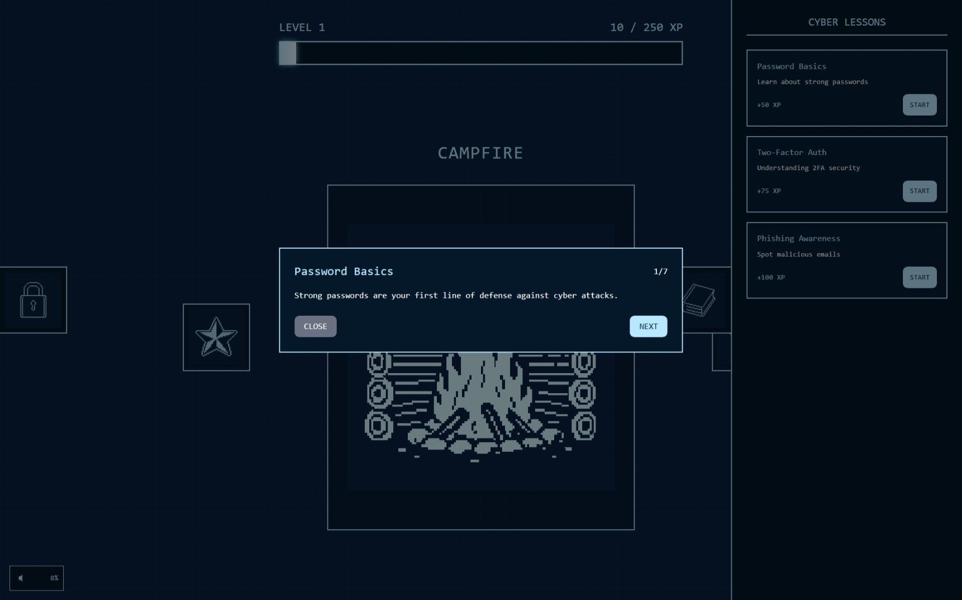

Slide 13


Slide 14
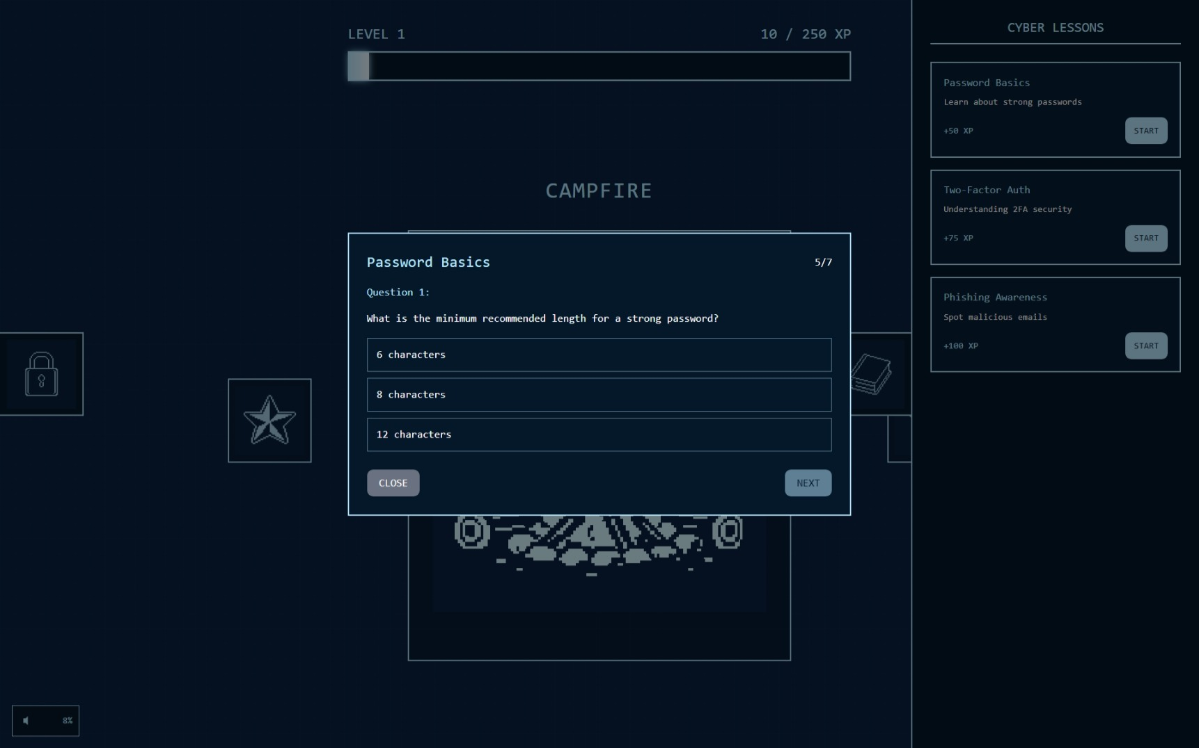

Slide 15
Inspiration
The inspiration for Fortify stems from the persistent and costly problem of poor password practices. Despite advances in security technologies, weak and reused credentials remain the leading cause of data breaches worldwide. In South Africa, cybercrime drains billions from the economy annually, much of it stemming from credential theft. Globally, IBM’s 2023 Cost of a Data Breach Report estimates an average loss of $4.45 million per incident.
The underlying issue isn’t a lack of tools, but rather human behavior. People continue to use “123456” or recycle the same password across accounts, often ignoring security advice because training is presented in dry, technical formats. The idea behind Fortify was to create a platform where improving your security feels enjoyable rather than burdensome. By making the process playful — a nostalgic game where better behavior leads to tangible progress — the project hopes to shift habits at the root, making lasting security improvements possible.

Slide 16
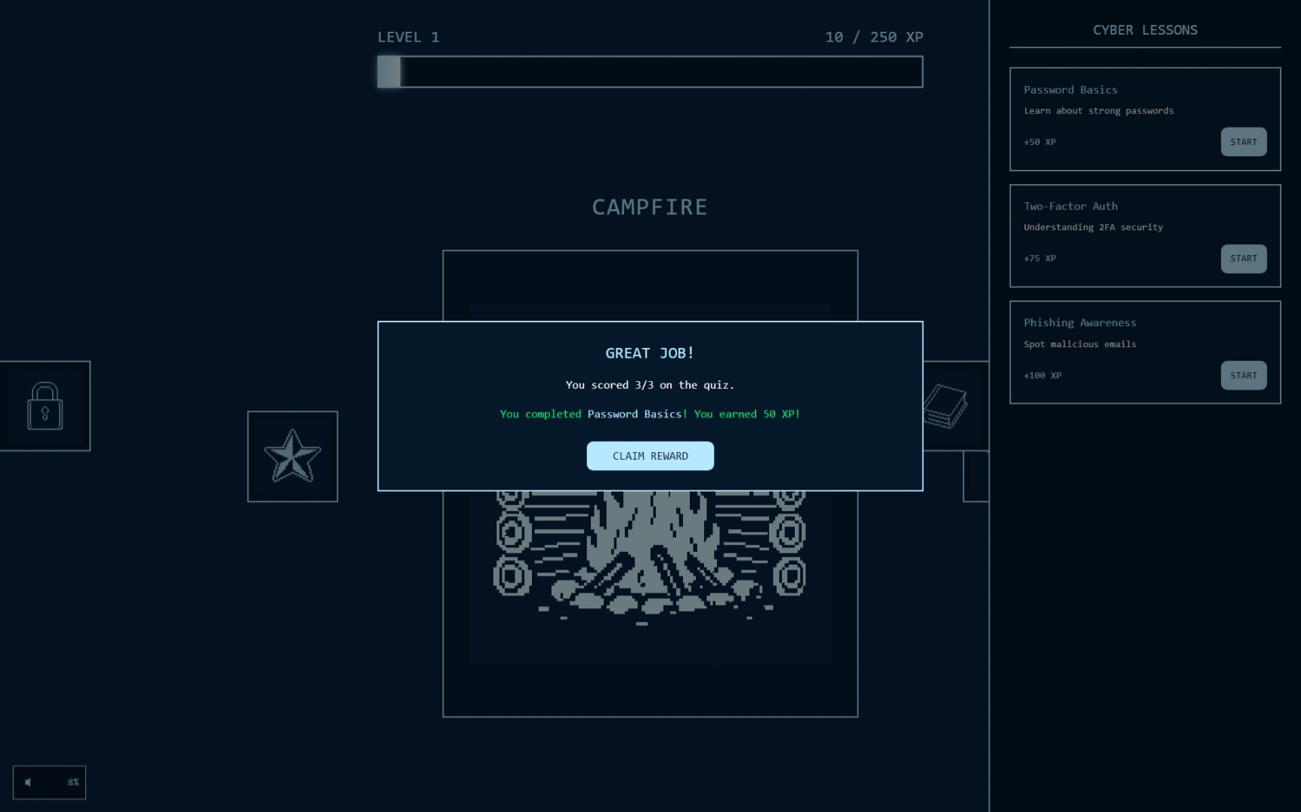

Slide 17
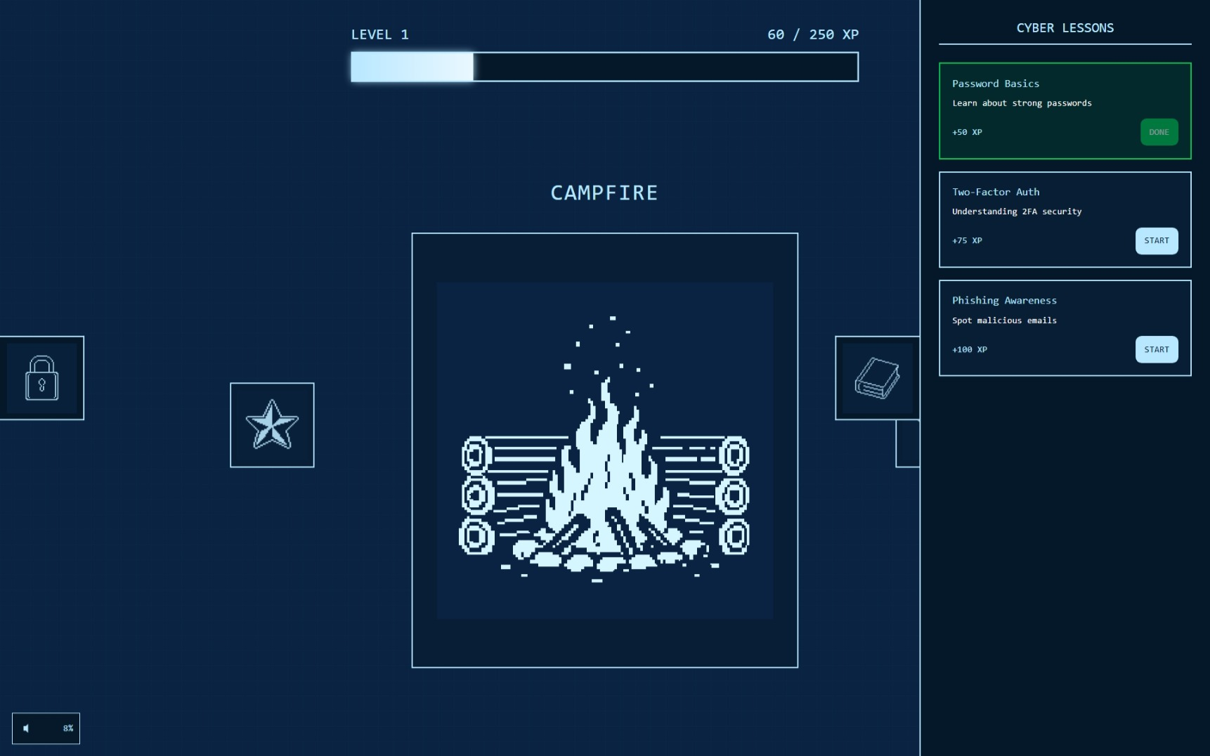

Slide 18
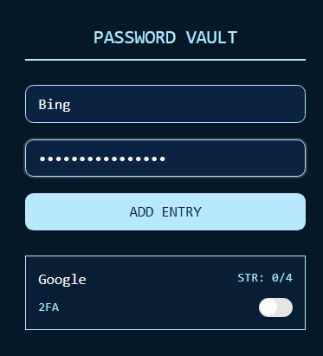

Slide 19
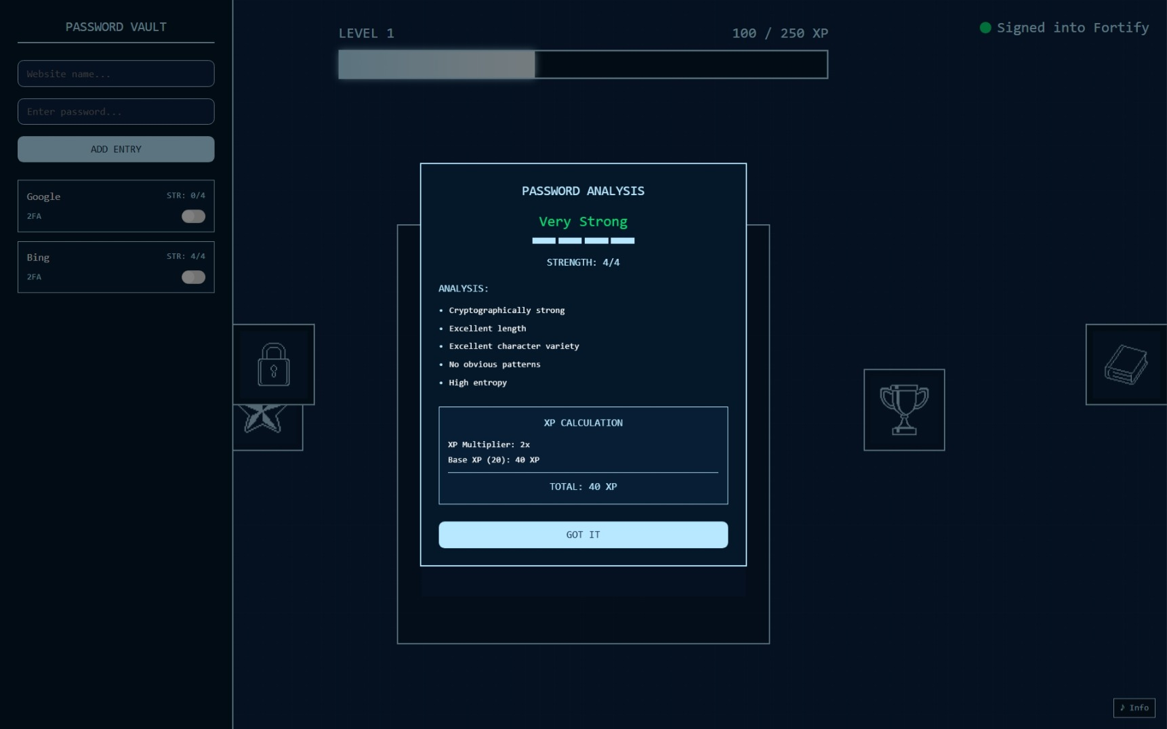

Slide 20
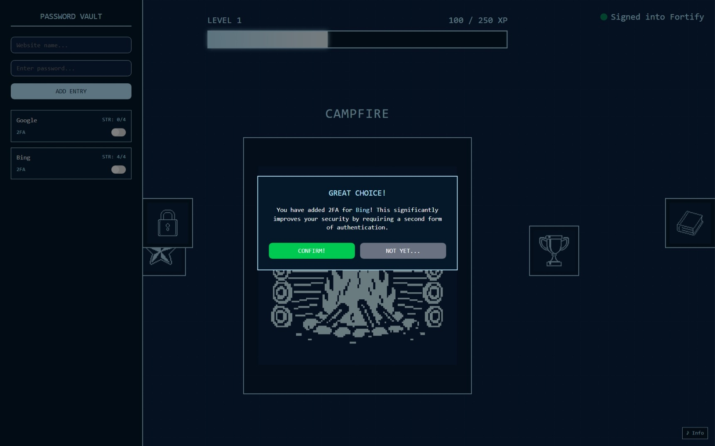

Slide 21
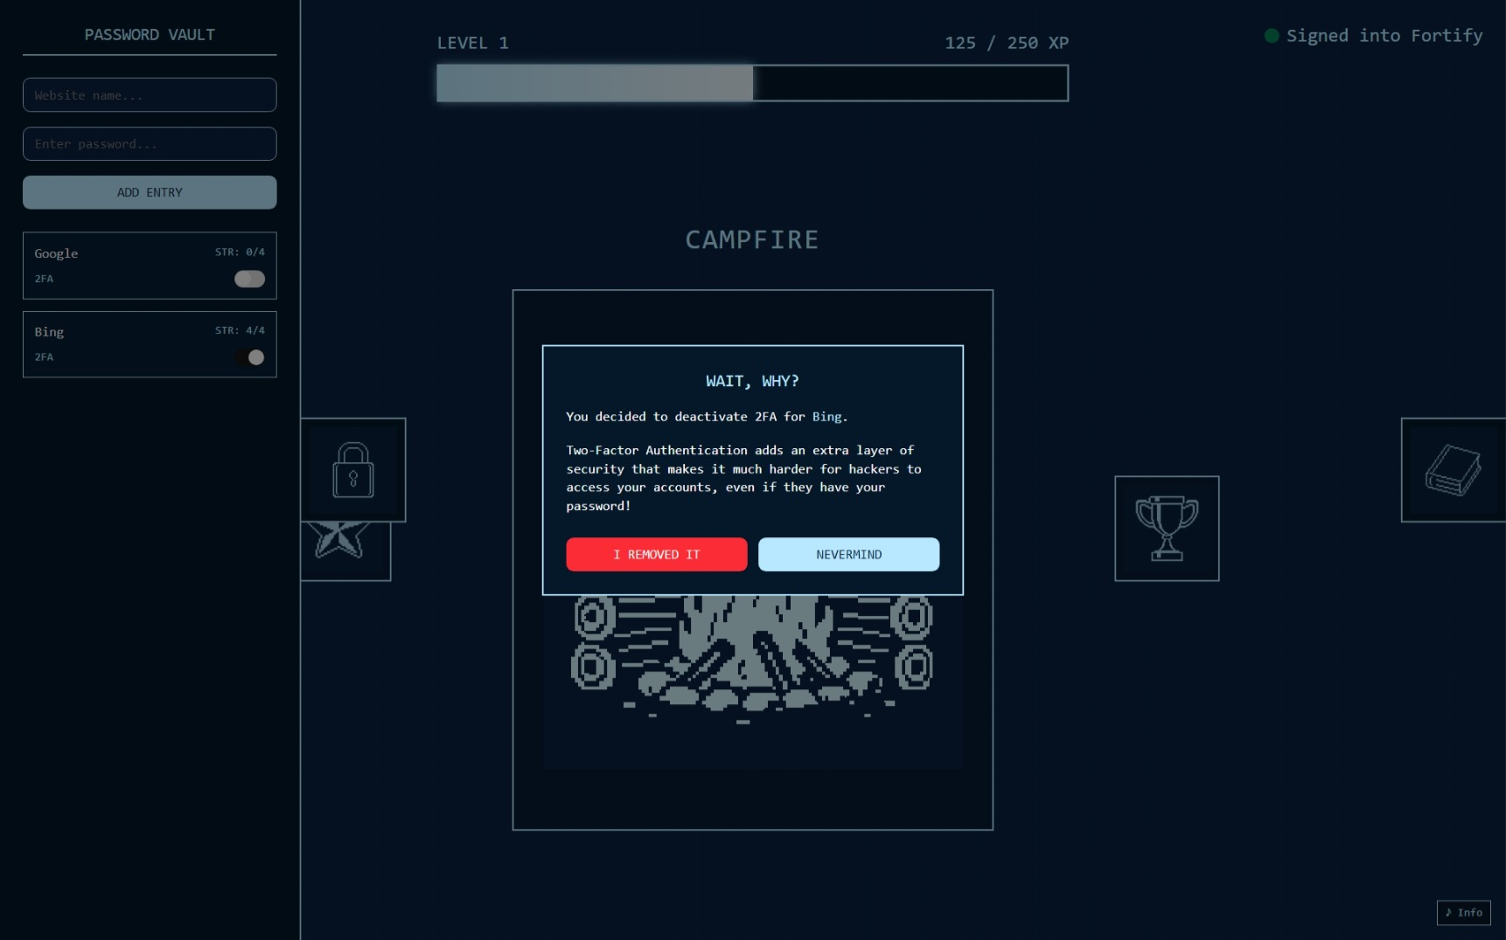

Slide 22
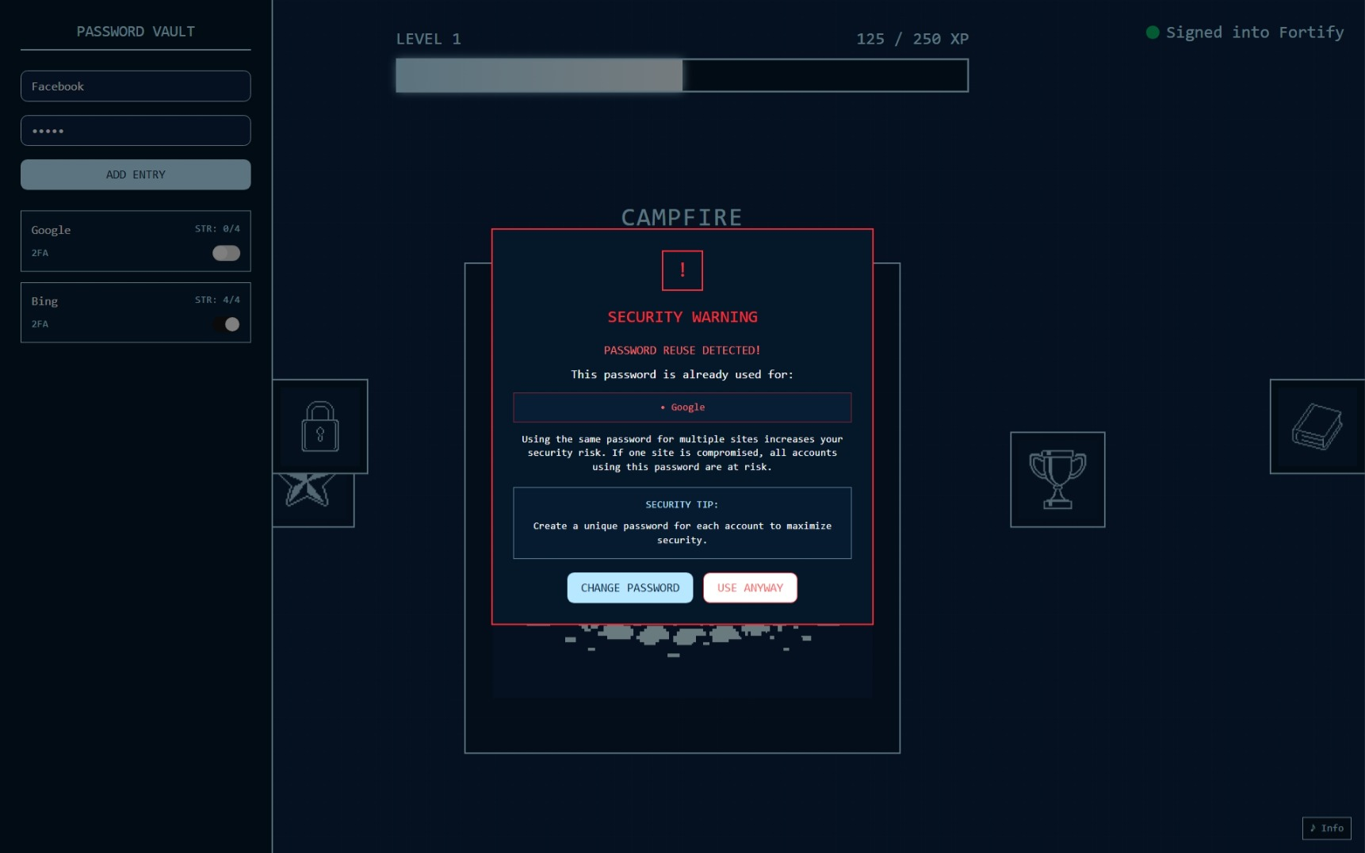

Slide 23
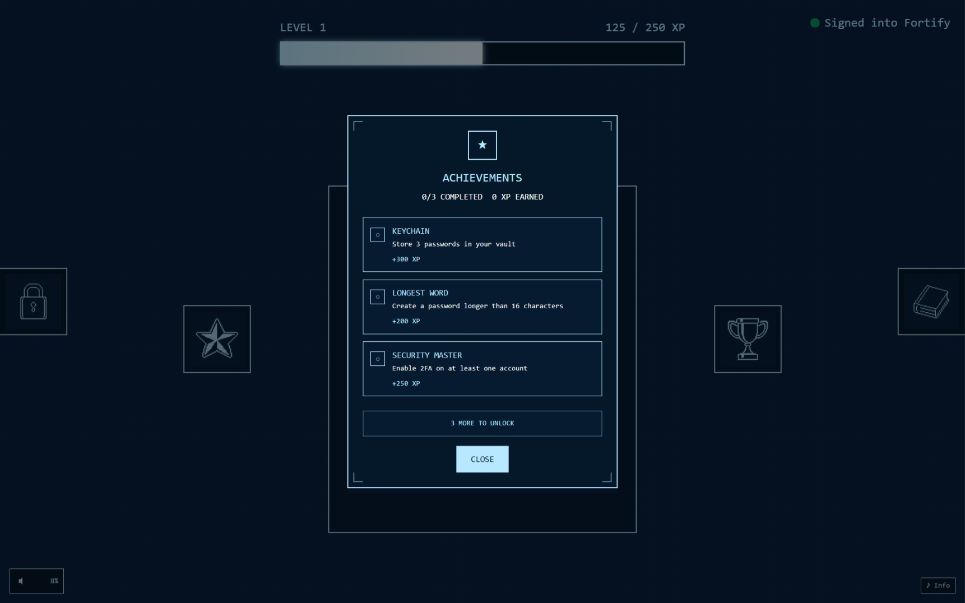

Slide 24
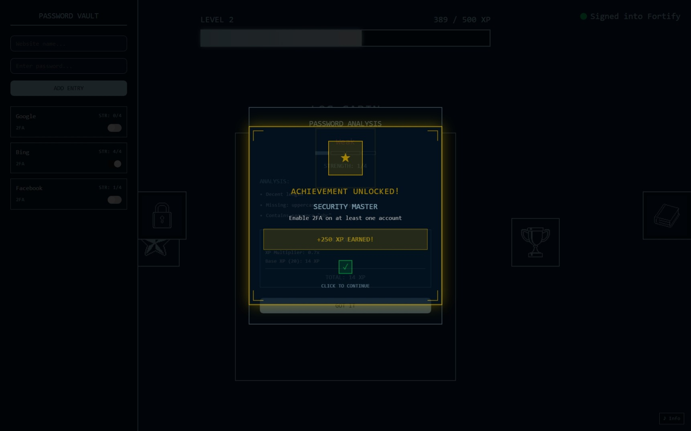

Slide 25
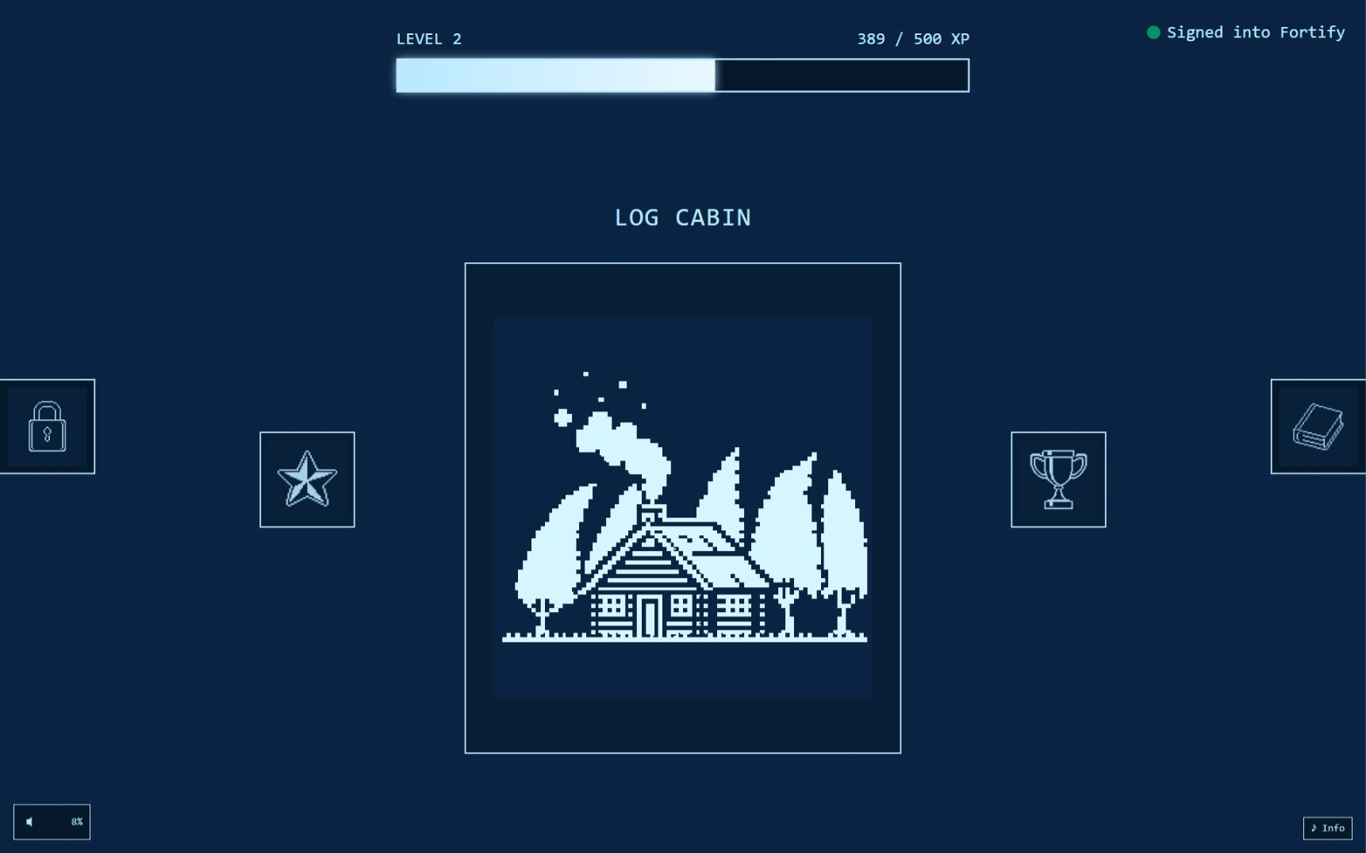

Slide 26
Art Direction
From the beginning, the vision was to present cybersecurity through a friendly and nostalgic lens. The art direction takes inspiration from retro “Game Boy” aesthetics, using pixel art and a blueprint color palette to create a sense of calm and familiarity. Instead of intimidating users with complex dashboards, Fortify invites them into a playful environment that feels more like building a childhood fort than navigating enterprise security.
The visuals evolve with the user’s progress: the campfire flickers, huts appear, walls rise, and finally a castle stands tall — all rendered in crisp pixel art. The interface uses soothing navy blue backgrounds and cyan linework reminiscent of blueprint schematics, tying into the theme of “planning your digital fortress.” To round out the atmosphere, light 8-bit chiptune music sets a relaxed and engaging mood. This design strategy helps lower the psychological barrier to security education, making users more likely to stay engaged and return.

Slide 27
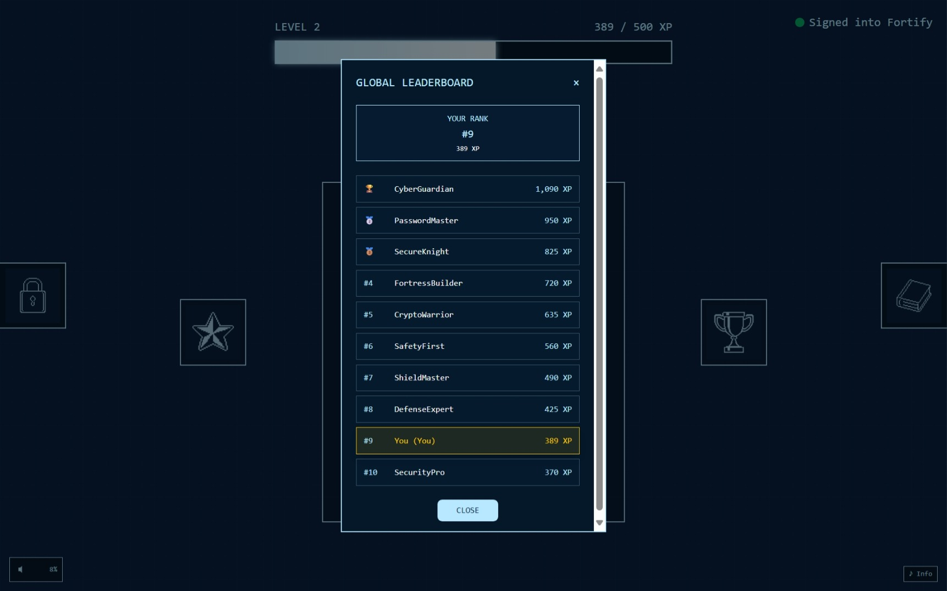

Slide 28
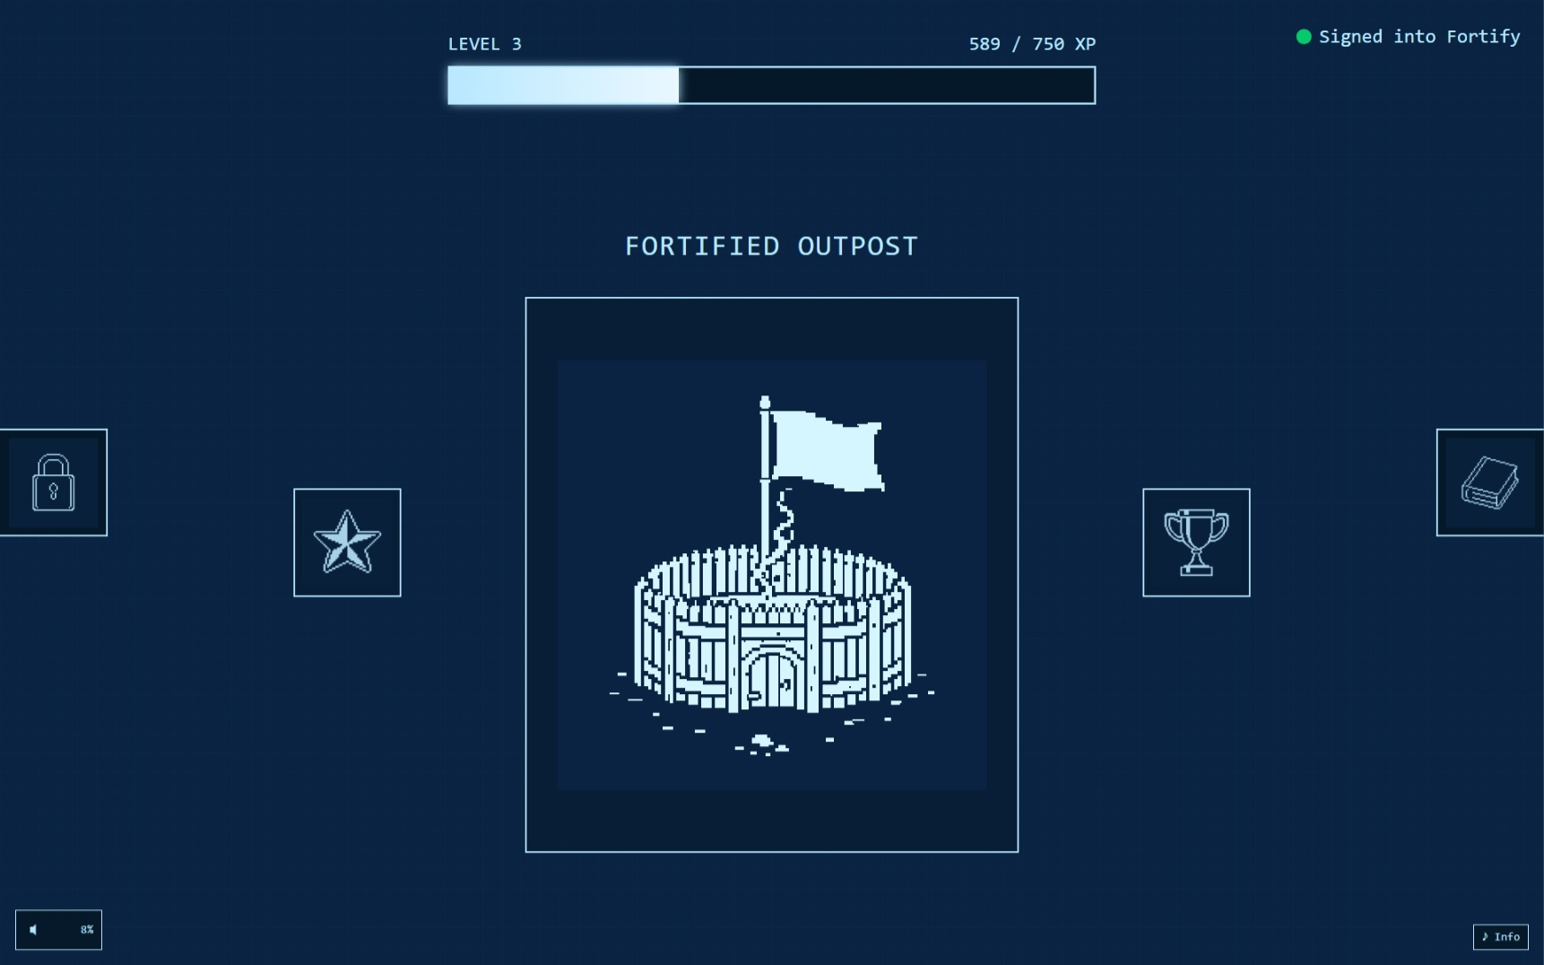

Slide 29
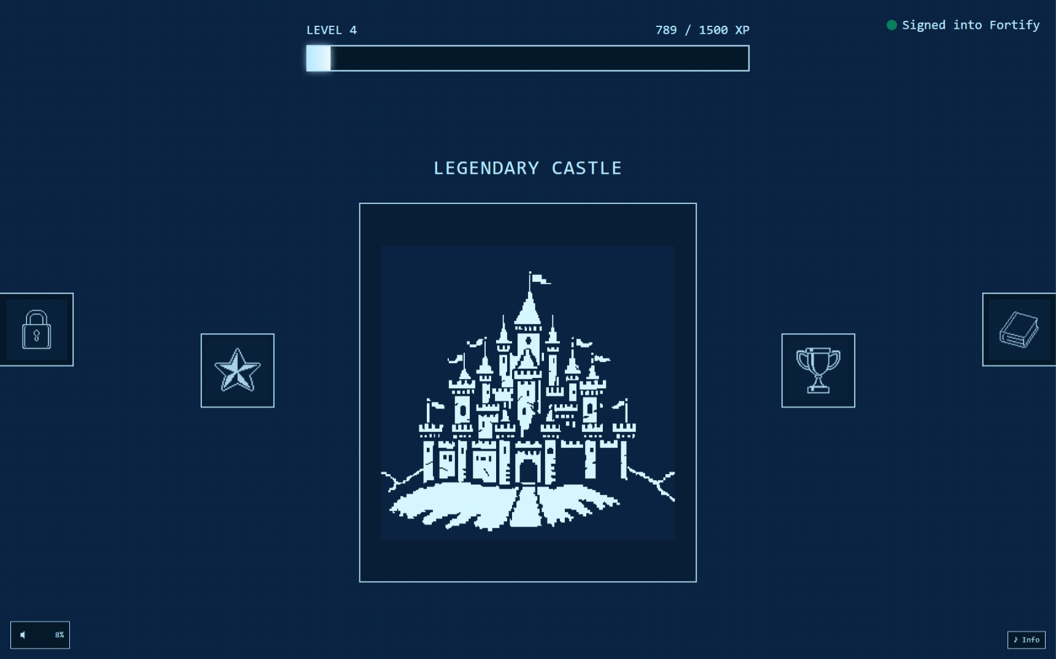

Slide 30
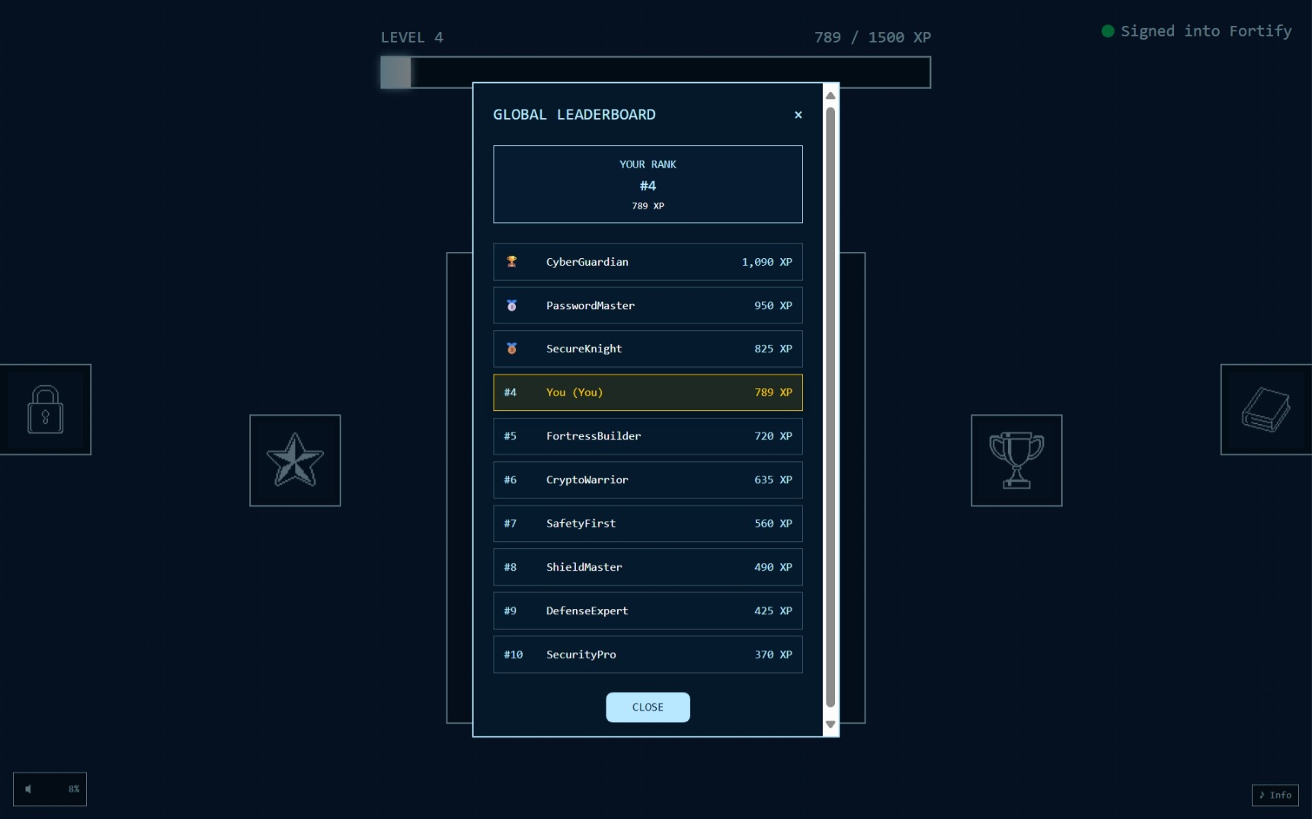

Slide 31
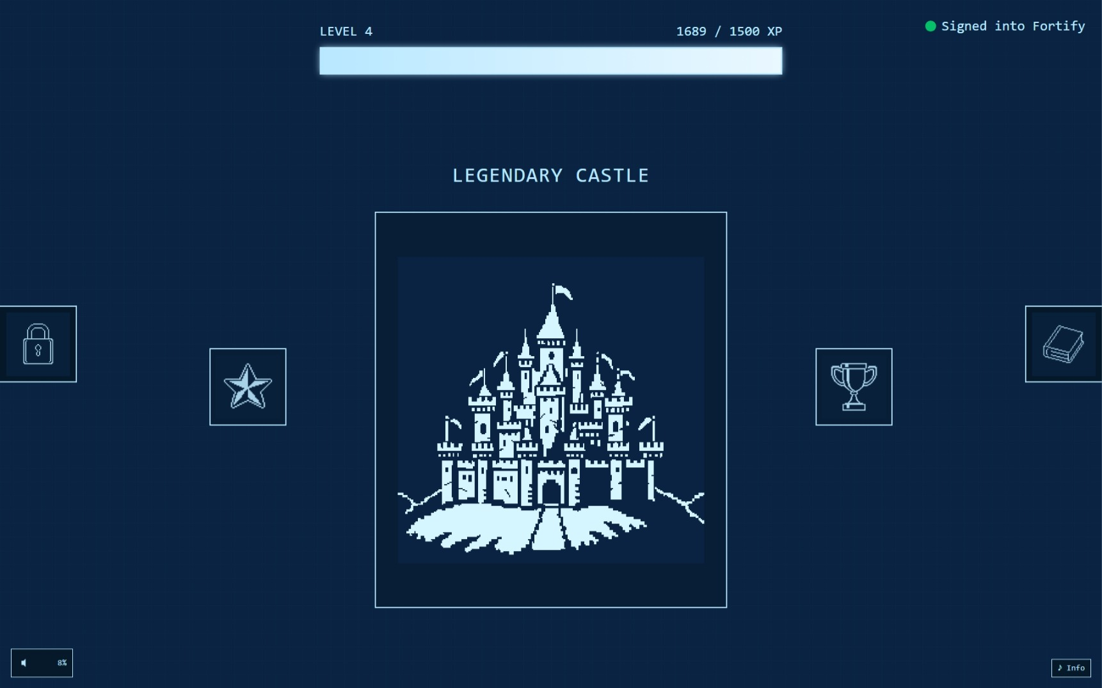

Slide 32
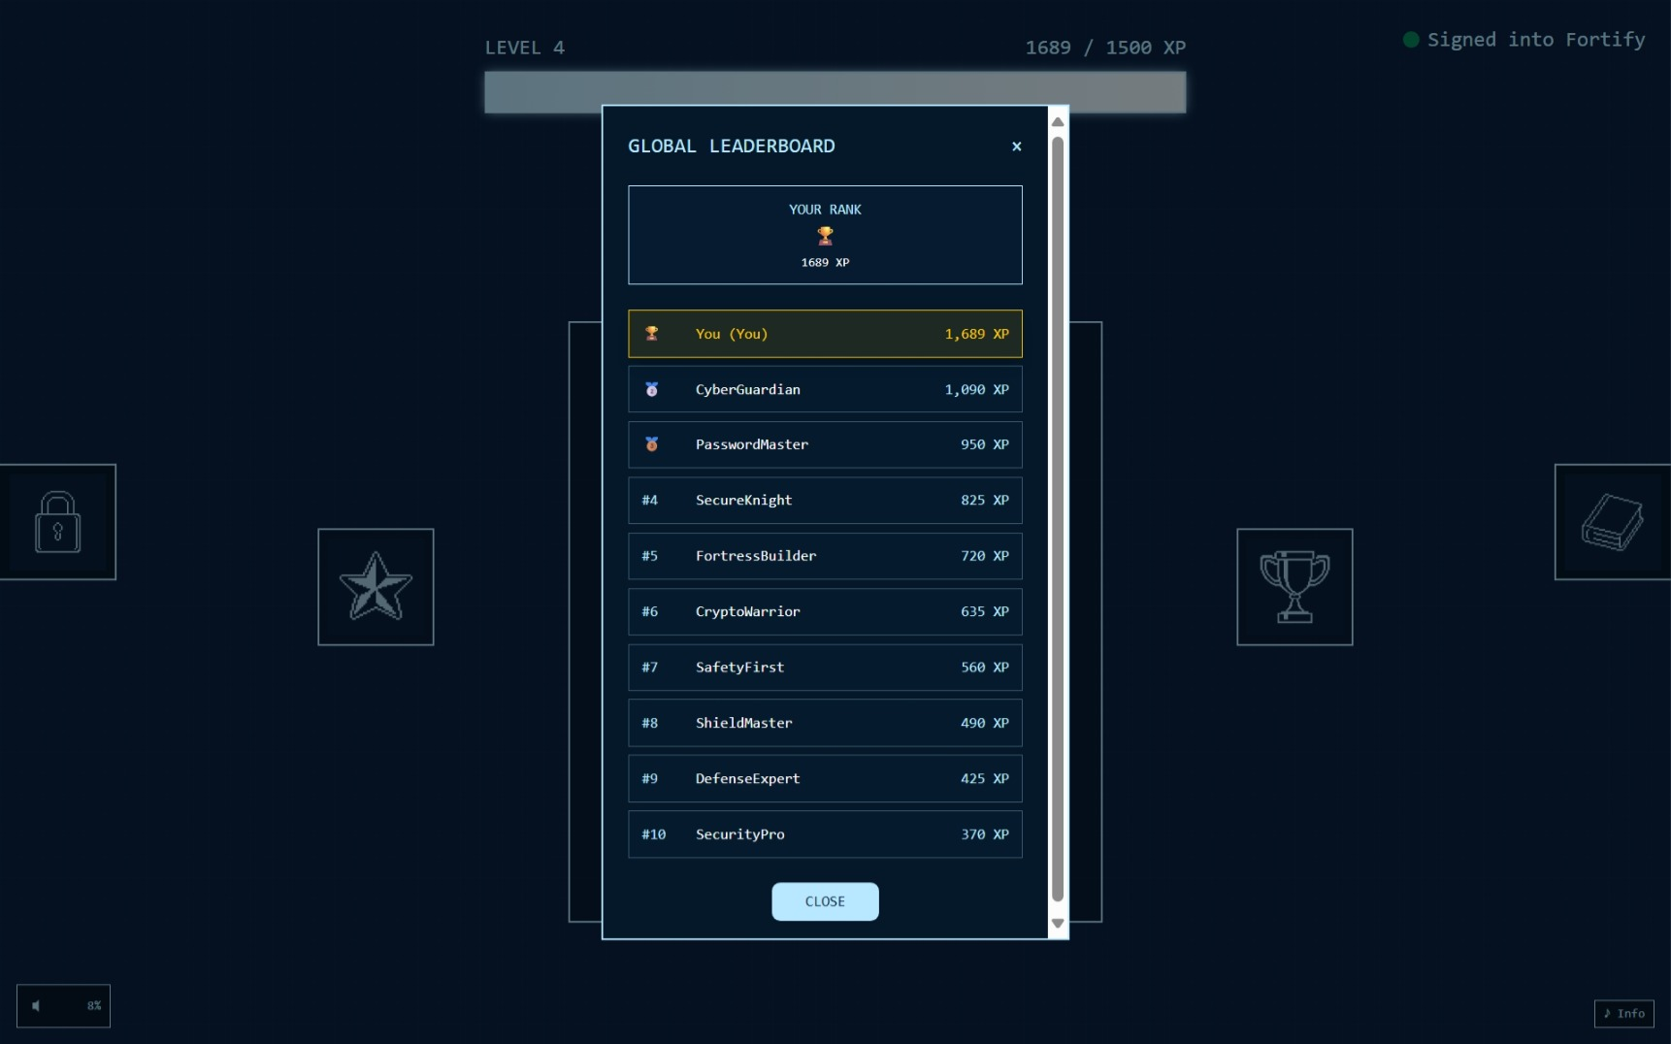

Slide 33
Future Improvements
Although Fortify already has a strong MVP, there are several exciting directions for growth. More achievement types could reward diverse behaviors, such as regularly updating passwords or avoiding reuse across different sites. Team competitions could add a social dimension, letting groups form guilds and collaborate on collective security goals. Lessons could expand beyond passwords into areas like phishing awareness, social engineering defenses, and safe browsing practices.
A mobile version would bring Fortify to a wider audience, while integration with real password managers could bridge the gap between simulation and daily use. Finally, adding breach notifications would make the app not just educational, but practically protective, alerting users when one of their accounts is exposed. These improvements would allow Fortify to grow from a prototype into a comprehensive security education and management ecosystem.

